Slide 1
Lecture 12:
Sorting-II
Keren Zhu
kerenzhu@cse.cuhk.edu.hk

Slide 2
Announcement
HW 5
PA 2 – No late submission is allowed
In future HWs, we will post more programming problems, but make them optional
  Will not be graded, and you can easily find the solutions online
  Programming assessments like Leetcode or weekly contests are not “real” targets of academia or industry, but are good to to learn the basic skills in early learning stages
Will require you to write reasoning for the algorithm analysis in the future
  An alone “O(n log n)” will get zero, even it’s correct

Slide 3
This lecture covers…
Heapsort
Merge Sort
Quick Sort
Note: many modern sorting implementations are not the standard merge sort and quick sort, but are hybrid
  eg. introsort begins with quick sort and switch to heap sort later
  eg. using insertion sort when the array size becomes small
  In HW, quiz and exam: use the standard sorting algorithms

Slide 4
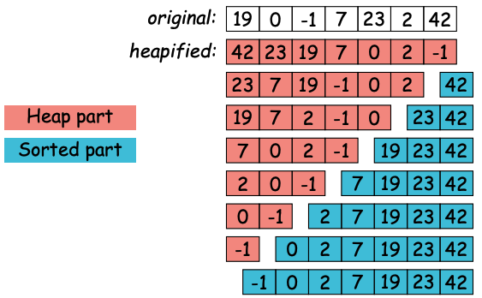
Sorting by selection: heapsort
Idea: Keep selecting the smallest (or largest) element
Very inefficient using a simple list or array (what is the complexity?)
Use heap instead

Slide 5
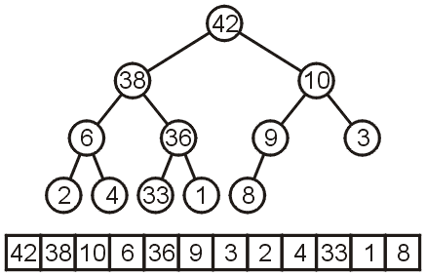
In-place Implementation
Instead of implementing a min-heap, consider a max-heap:
  A heap where the maximum element is at the top of the heap and the next to be popped

Slide 6

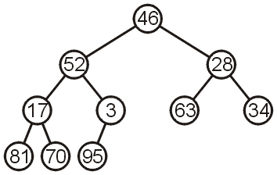
In-place Heapification
Now, consider this unsorted array:
This array represents the following complete tree:
This is neither a min-heap, max-heap, or binary search tree

Slide 7
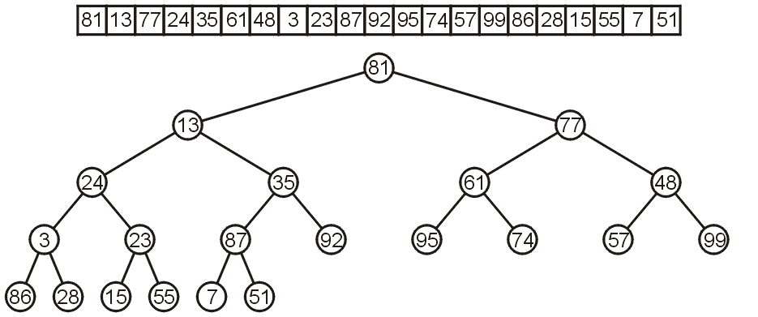
Idea of Heapification
Note: all leaf nodes are already max heaps, and then we can make corrections so that the previous nodes also form max heaps
Bottom-up heapify

Slide 8
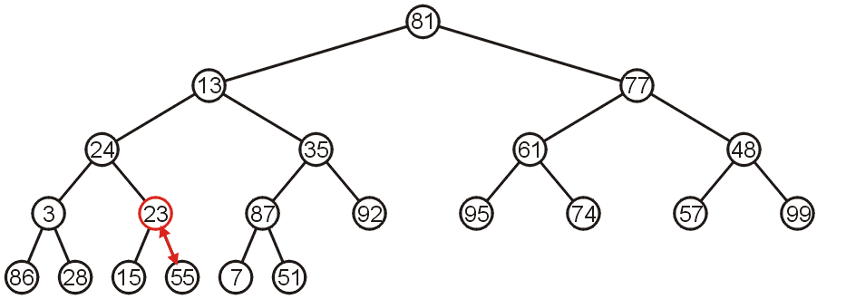
In-place Heapification
The subtree with 23 is not a max-heap, but swapping it with 55 creates a max-heap
This process is termed percolating down
In which heap operation we would do similar thing?

Slide 9
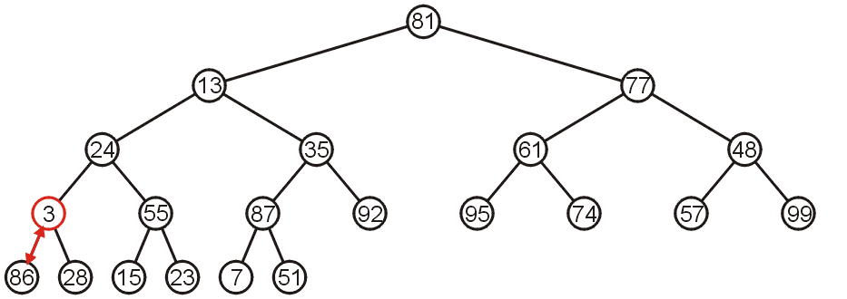
In-place Heapification
The subtree with 3 as the root is not max-heap, but we can swap 3 and the maximum of its children: 86

Slide 10
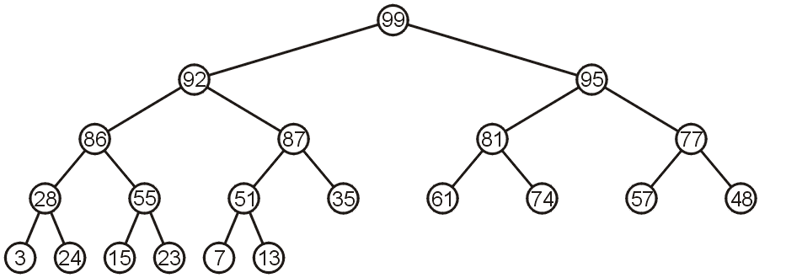
In-place Heapification
We can repetitively doing the fix
The final product is a max-heap

Slide 11
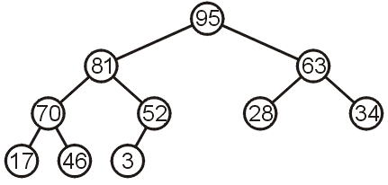
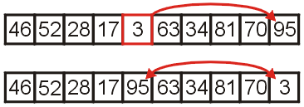
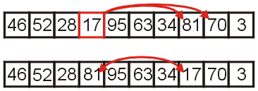
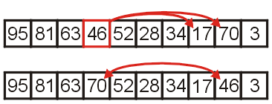
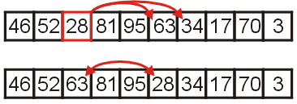
Illustration of heapsort
We first heapify an array

Slide 12

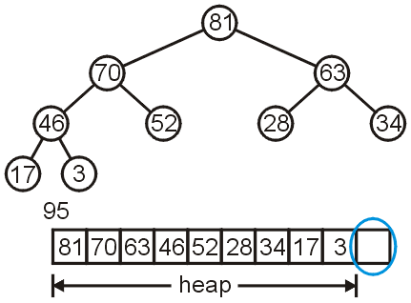
Illustration of heapsort
Then we extract the head and put it the gap space

Slide 13
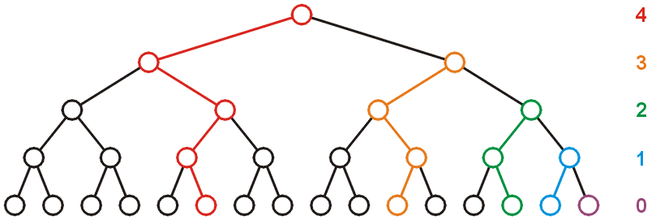
Run-time Analysis of Heapify
Considering a perfect tree of height h:
  The maximum number of swaps which a second-lowest level would experience is 1, the next higher level, 2, and so on

Slide 14
Run-time Analysis of Heapify
At depth k, there are 2^{k} nodes and in the worst case, all of these nodes would have to percolated down h – k levels
  In the worst case, this would requiring a total of 2^{k}(h – k) swaps
Writing this sum mathematically, we get:

Slide 15
Run-time Analysis of Heapify
Recall that for a perfect tree, n = 2^{h + 1} – 1 and h + 1 = lg(n + 1), therefore
Each swap requires two comparisons (which child is greatest), so there is a maximum of 2n (or Θ(n)) comparisons

Slide 16
Heap Sort
Heapification runs in Θ(n)
Popping n items from a heap of size n, as we saw, runs in Θ(n ln(n)) time
  We are only making one additional copy into the blank left at the end of the array
Therefore, the total algorithm will run in Θ(n ln(n)) time

Slide 17
Heap Sort
There are no worst-case scenarios for heap sort
  Dequeuing from the heap will always require the same number of operations regardless of the distribution of values in the heap
There is one best case: if all the entries are identical, then the run time is Θ(n)
The original order may speed up the heapification, however, this would only speed up an Θ(n) portion of the algorithm

Slide 18
Run-time Summary
The following table summarizes the run-times of heap sort
Case | Run Time | Comments
Worst | Θ(n ln(n)) | No worst case
Average | Θ(n ln(n))
Best | Θ(n) | All or most entries are the same

Slide 19
Merge sort
The methodology is recursively
  If the list/array size is 1, then we are done
  Otherwise:
    Divide an unsorted list into two sub-lists,
    Sort each sub-list recursively using merge sort, and
    Merge the two sorted sub-lists into a single sorted list
The method is divide-and-conquer
Question: How quickly can we recombine the two sub-lists into a single sorted list?

Slide 20
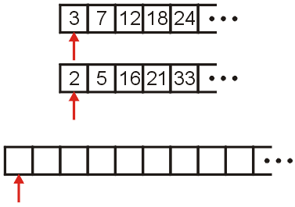
Merging Example
Consider the two sorted arrays and an empty array
Define three indices at the start of each array

Slide 21
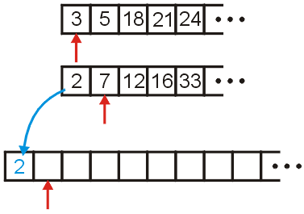
Merging Example
We compare 2 and 3: 2 < 3
  Copy 2 down
  Increment the corresponding indices

Slide 22
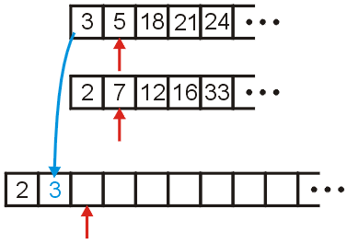
Merging Example
We compare 3 and 7
  Copy 3 down
  Increment the corresponding indices

Slide 23
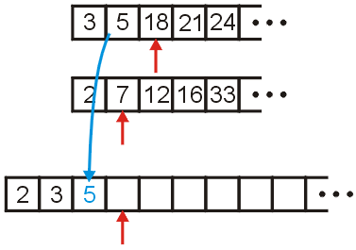
Merging Example
We compare 5 and 7
  Copy 5 down
  Increment the appropriate indices

Slide 24
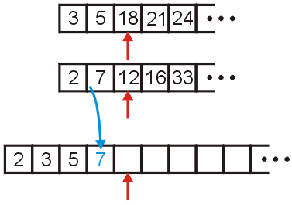
Merging Example
We compare 18 and 7
  Copy 7 down
  Increment...

Slide 25
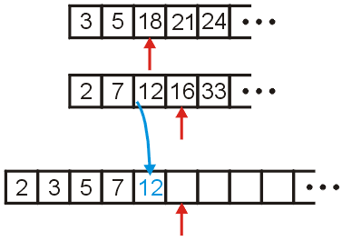
Merging Example
We compare 18 and 12
  Copy 12 down
  Increment...

Slide 26
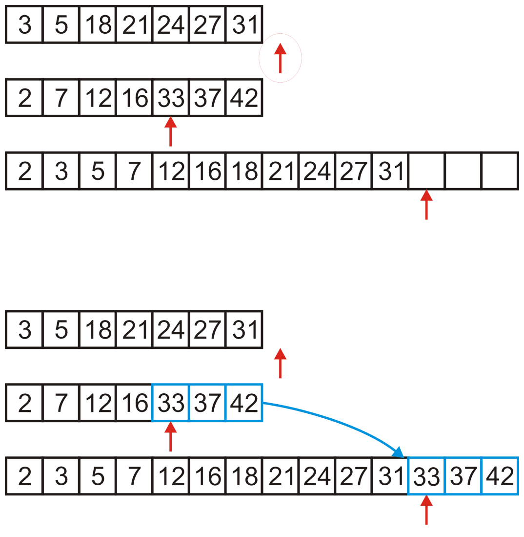
Merging Example
We would continue until we have passed beyond the limit of one of the two arrays
After this, we simply copy over all remaining entries in the non-
empty array
Overall, the merge is Θ(n)

Slide 27
The merge sort algorithm
Question:
  we split the list into two sub-lists and sorted them
  how should we sort those lists?
Answer (theoretical and standard):
  if the size of these sub-lists is > 1, use merge sort again
  if the sub-lists are of length 1, do nothing: a list of length one is sorted
Answer (practical):
  If the sub-lists are less than some threshold length, use an algorithm like insertion sort to sort the lists
  Otherwise, use merge sort, again

Slide 28
Implementation
For example, given the array,
a call to
void merge( array, 14, 20, 26 );
merges the two sub-lists
forming
9 | 10 | 11 | 12 | 13 | 14 | 15 | 16 | 17 | 18 | 19 | 20 | 21 | 22 | 23 | 24 | 25 | 26 | 27 | 28 | 29 | 30 | 31 | 32 | 33
13 | 77 | 49 | 35 | 61 | 3 | 23 | 48 | 73 | 89 | 95 | 17 | 32 | 37 | 57 | 94 | 99 | 28 | 15 | 55 | 7 | 51 | 88 | 97 | 62
9 | 10 | 11 | 12 | 13 | 14 | 15 | 16 | 17 | 18 | 19 | 20 | 21 | 22 | 23 | 24 | 25 | 26 | 27 | 28 | 29 | 30 | 31 | 32 | 33
13 | 77 | 49 | 35 | 61 | 3 | 23 | 48 | 73 | 89 | 95 | 17 | 32 | 37 | 57 | 94 | 99 | 28 | 15 | 55 | 7 | 51 | 88 | 97 | 62
9 | 10 | 11 | 12 | 13 | 14 | 15 | 16 | 17 | 18 | 19 | 20 | 21 | 22 | 23 | 24 | 25 | 26 | 27 | 28 | 29 | 30 | 31 | 32 | 33
13 | 77 | 49 | 35 | 61 | 3 | 17 | 23 | 32 | 37 | 48 | 57 | 73 | 89 | 94 | 95 | 99 | 28 | 15 | 55 | 7 | 51 | 88 | 97 | 62

Slide 29
Implementation example
  template <typename Type>
  void merge_sort( Type *array, int first, int last ) {
  if ( last - first > 1) {
  int midpoint = (first + last)/2;
  merge_sort( array, first, midpoint );
  merge_sort( array, midpoint, last );
  merge( array, first, midpoint, last );
  }
  }

Slide 30
Run-time Analysis of Merge Sort
Thus, the time required to sort an array of size n > 1 is:
  the time required to sort the first half,
  the time required to sort the second half, and
  the time required to merge the two lists
That is:

Slide 31
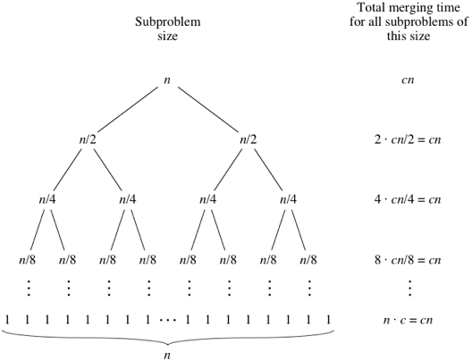

Run-time Analysis of Merge Sort
Each time the problem size is divided by half
Solving the recursion or using Master theorem giving you $Θ$(n logn)

Slide 32
Run-time Summary
The following table summarizes the run-times of merge sort
Case | Run Time | Comments
Worst | Θ(n ln(n)) | No worst case
Average | Θ(n ln(n))
Best | Θ(n ln(n)) | No best case

Slide 33
Why is it not O(n²)
When we are merging, we are comparing values
  What operation prevents us from performing O(n²) comparisons?
  During the merging process, if 2 came from the second half, it was only compared to 3 and it was not compared to any other of the other n – 1 entries in the first array
  In this case, we remove n inversions with one comparison

Slide 34
Quick sort
We have seen two Θ(n log(n)) sorting algorithms:
  Heap sort which allows in-place sorting, and
  Merge sort which is faster but requires more memory
We will now look at a recursive algorithm which may be done almost in place but which is faster than heap sort
  Use an object in the array (a pivot) to divide the two
  Average case: Θ(n log(n)) time and Θ(log(n)) memory
  Worst case: Θ(n²) time and Θ(n) memory
Idea: Chose an object in the array and partition the remaining objects into two groups relative to the chosen entry

Slide 35
Quicksort
For example, given
we can select the middle entry, 44, and sort the remaining entries into two groups, those less than 44 and those greater than 44:
Notice that 44 is now in the correct location if the list was sorted
  Proceed by applying the algorithm to the first six and last eight entries
80 | 38 | 95 | 84 | 66 | 10 | 79 | 44 | 26 | 87 | 96 | 12 | 43 | 81 | 3
38 | 10 | 26 | 12 | 43 | 3 | 44 | 80 | 95 | 84 | 66 | 79 | 87 | 96 | 81

Slide 36
Run-time analysis
Like merge sort, we can either:
  Apply insertion sort if the size of the sub-list is sufficiently small, or
  Sort the sub-lists using quicksort
In the best case, the list will be split into two approximately equal sub-lists, and thus, the run time could be very similar to that of merge sort: Θ(n log(n))
What happens if we don’t get that lucky?

Slide 37
Worst-case scenario
Suppose we choose the first element as our pivot and we try ordering a sorted list:
Using 2, we partition into
We still have to sort a list of size n – 1
The run time is T(n) = T(n – 1) + Θ(n) = Θ(n²)
  Thus, the run time drops from n log(n) to n²
80 | 38 | 95 | 84 | 66 | 10 | 79 | 2 | 26 | 87 | 96 | 12 | 43 | 81 | 3
2 | 80 | 38 | 95 | 84 | 66 | 10 | 79 | 26 | 87 | 96 | 12 | 43 | 81 | 3

Slide 38
Implementation
The implementation is straight-forward
    template <typename Type>
    void quicksort( Type *array, int first, int last ) {
    if ( last - first > 1) {
    Type pivot = find_pivot( array, first, last );
    int low = find_next( pivot, array, first + 1 );
    int high = find_previous( pivot, array, last - 2 );
    while ( low < high ) {
    std::swap( array[low], array[high] );
    low = find_next( pivot, array, low + 1 );
    high = find_previous( pivot, array, high - 1 );
    }
    array[last – 1] = array[low];
    array[low] = pivot;
    quicksort( array, first, low );
    quicksort( array, high, last );
    }
    }
The pivot selection method can have great impact on the efficiency
The best-case is that the pivot always divide the array in half

Slide 39
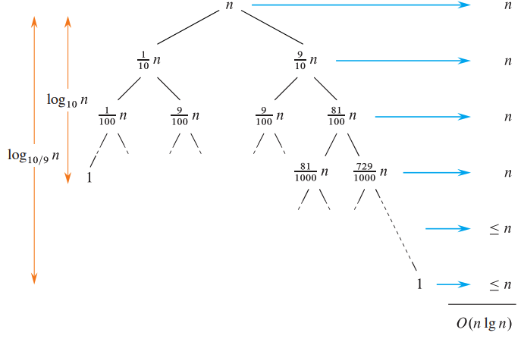
The average runtime
Exam won’t ask to do average runtime complexity analysis
The average runtime for quick sort is O(n log(n) )
Suppose the pivot always produces a 0-to-1 split

Slide 40
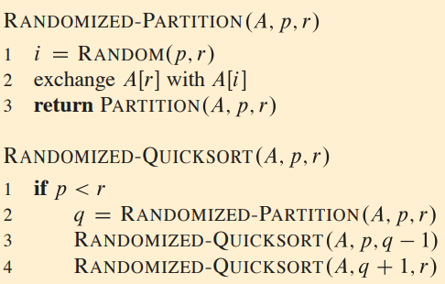
The average runtime
Random pivot produces an expected runtime of O(n log(n))
  See CLRS Chapter 7
In reality, sample a few numbers and select the median is also a good strategy

Slide 41
Run-time Summary
To summarize all three Θ(n log(n)) algorithms
 | Average Run Time | Worst-case Run Time | Average Memory | Worst-case Memory
Heap Sort | Θ(n log(n)) |  | Θ(1)
Merge Sort | Θ(n log(n)) |  | Θ(n)
Quicksort | Θ(n log(n)) | Θ(n²) | Θ(log(n)) | Θ(n)

Slide 42
Quick selection (not in final)
Get average Θ(n) for selecting k-th smallest element
  Partition around sound pivot p, as in quicksort
  Suppose that in the result, pivot is at index m
  If m=k, p is the answer
  if m>k, recursively select k-th from the left half partition
  If m>k, recursively select (k-m-1)-th from the right partition

